Slide 1
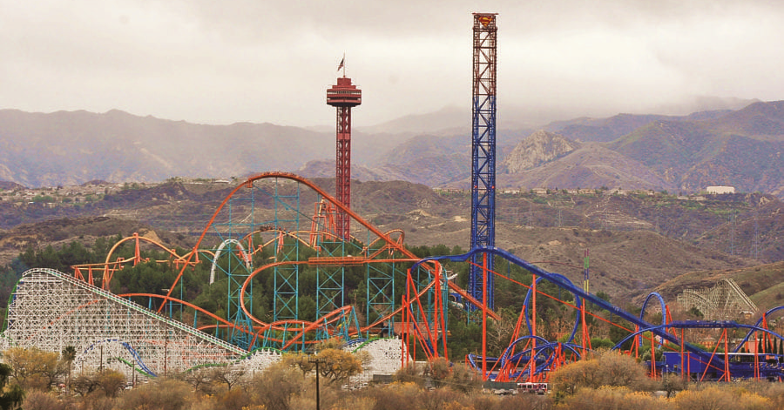
Roller Coaster Physics at
Six Flags Magic Mountain

Slide 2
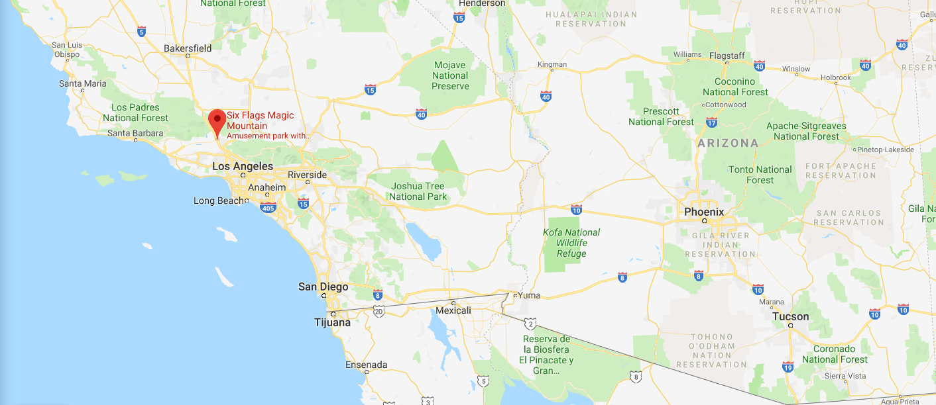
Six Flags is located 35 miles north of LA in Valencia, California
Approximately a 6 hour drive from Phoenix, Arizona

Slide 3
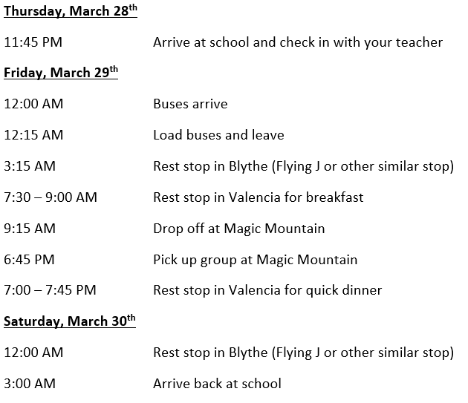
The quickest, easiest, cheapest way to take students to Magic Mountain is on a turnaround trip. Here was our itinerary from last year - 27 hours of FUN!

Slide 4
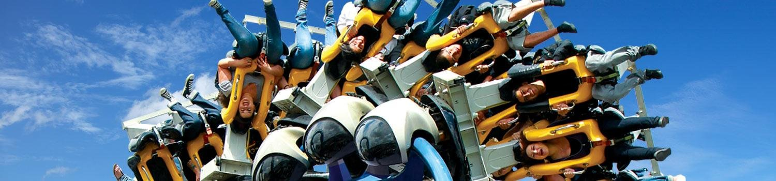
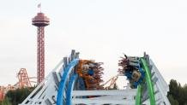
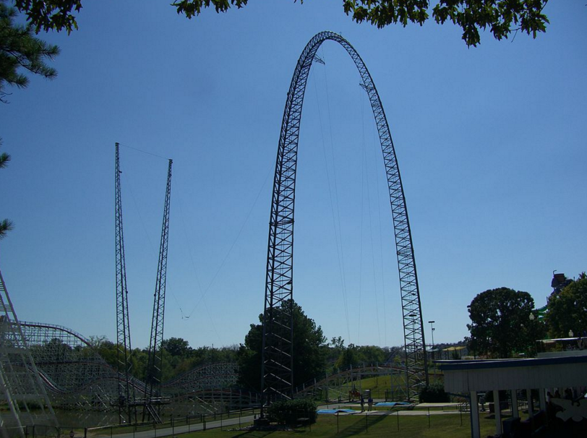
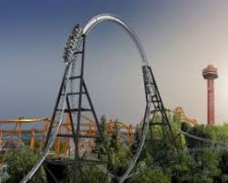
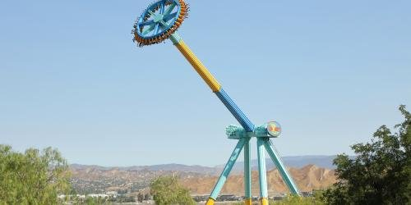

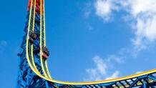
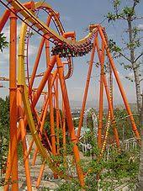
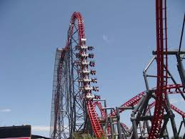
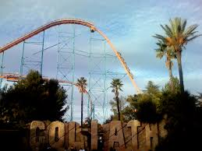
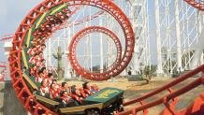
Six Flags Magic Mountain – website
14 crazy roller coasters
Several other thrill rides
A few gentler and/or kids rides

Slide 5
Roller Coaster Physics at Magic Mountain
Student are given a lab packet with (currently) 11 labs in the packet that are broken into “types”. Each type has general focus.
  Type A labs – Kinematics
  Type B labs – Conservation of Energy
  Type C labs – Circular Motion
  Type D labs – Forces (Centripetal force)
There is a lot of overlap in the labs, most include a focus on how the rider feels at different points in the ride and the g-forces on the rider.
Students are required to complete one lab of each type.

Slide 6
Measurements
Students must learn to take measurements in the park and be comfortable with reasonable approximations.
  Distance and height – pacing, uniformity in structure, triangulation, published data on the rides, phone apps
  Timing – stopwatch or phone app
  Accelerations – accelerometer*
*Due to recent restrictions on the rides, I recently rewrote the lab packet to remove all direct measurements of acceleration and instead asked students to estimate accelerations based on how they feel during different spots on the ride.

Slide 7
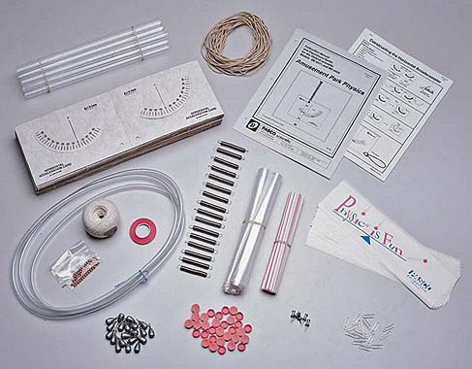
Accelerometers
While there are a few different brands (and you could build your own) the most common accelerometers are the ones from Pasco Scientific.
These kits will set you back $129 dollars for 15 kits and you have to put them together yourself.
Unfortunately, the park has banned taking the accelerometers on many of their rides.
Ann is here today to show us an exciting new option!

Slide 8
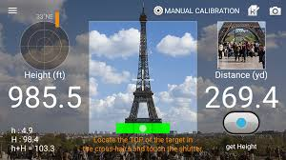
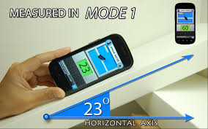
Phone Apps
IMPORTANT – Right up front, tell kids that they should not be using their phones while they are on the rides. I do not encourage the use of accelerometer/altimeter apps that students might be tempted to use on a ride.
Triangulation Apps
Angle Measure Apps

Slide 9
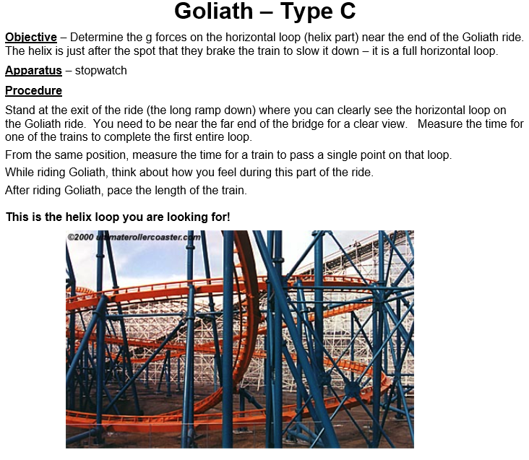

Slide 10
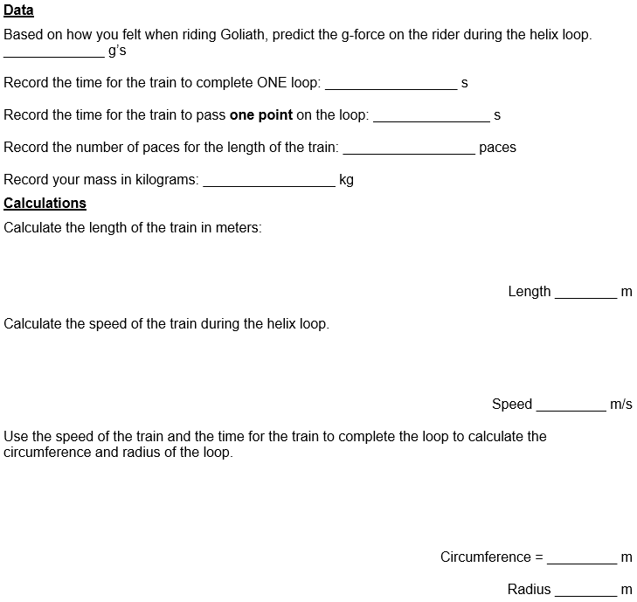

Slide 11
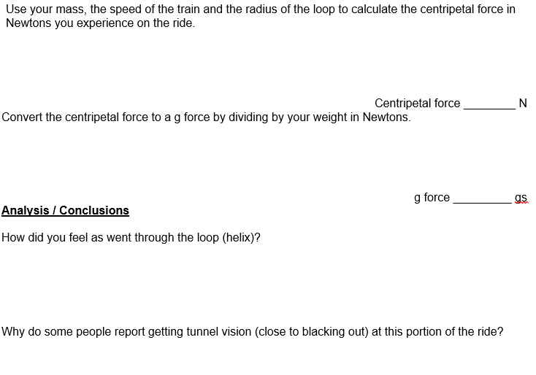

Slide 12
Planning Logistics
Trip request/approval by school district
  Trip Request
  Secure chaperones
    Chaperone ratio 1:15 for Magic Mountain
    Background checks
  Secure funding
Tickets from Magic Mountain
  Group rates for groups from 15-99, must pay for tickets in advance.
  Group rates for groups of 100+ allows for your group to get your tickets on consignment. Any number of tickets will be sent to you in advance, after the trip you return unused tickets along with your payment for the used tickets.

Slide 13
Planning Logistics
Charter Bus
  You need to find a bus company that will do a turnaround trip. Some companies require multiple drivers, driver swapping, etc. that will add to the cost.
  You will need to secure a hotel room for your drivers to stay at while your group is at the park. Many bus companies can do this for you as a part of their service.
  We have always provided our drivers with a tip as well. ($100 per driver)

Slide 14
Costs (these values are from last spring)
Bus cost - All Aboard America
$3730 per 56 passenger bus
$100 tip per bus
$20 water bottles
$3850 TOTAL
Ticket cost – for group over 100
$38 per ticket
Assuming about 40 students per bus = $134 per student

Slide 15
What do you do with students who can’t/don’t want to come?
Participation rates vary a lot from school to school. I get about 75% participation.
Provide a project that allows student to make similar calculations without being on the trip.
  I use a project that has students create a scale model of a roller coaster and show calculations for 6 points along the ride showing the g-force on the riders. They are required to shape the roller coaster in order to keep the g-forces in a small range intended to make the roller coaster safe but fun.
  Some teachers use a video analysis of roller coaster videos.
  Some teachers give all students a quiz or test after the project in order to assess all students by the same measure.

Slide 16

Other Options
Disneyland – I have never taken students to Disneyland instead of Magic Mountain but I know that there are teachers who have an may already have labs created for the rides at Disneyland.
Through their Disney Youth Education Series, Disney does offer some education programs in their parks. Some of these Programs are geared toward High School physics programs.

Slide 17
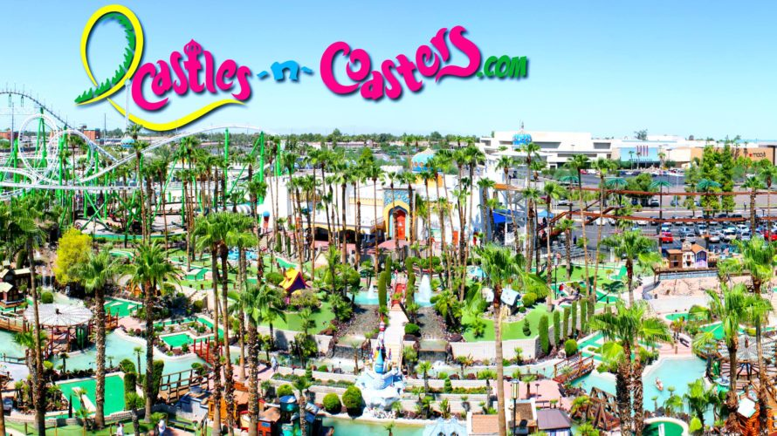
Other Options
Castles ‘n Coasters – We have a small amusement park here in Arizona where similar activities could be done in a smaller day trip with your students.
  Tom Vining and the Physics Club at Desert Mountain High School host a Physics Day at Castles and Coasters event every spring (usually February). If you don’t already receive in invite to this event in the mail, email tvining@susd.org to ask for more information or visit his website.
Physics Day at Castles ‘n Coasters includes competitions and activities that students can participate in as well such as tower building, egg drop, etc.

